Slide 1
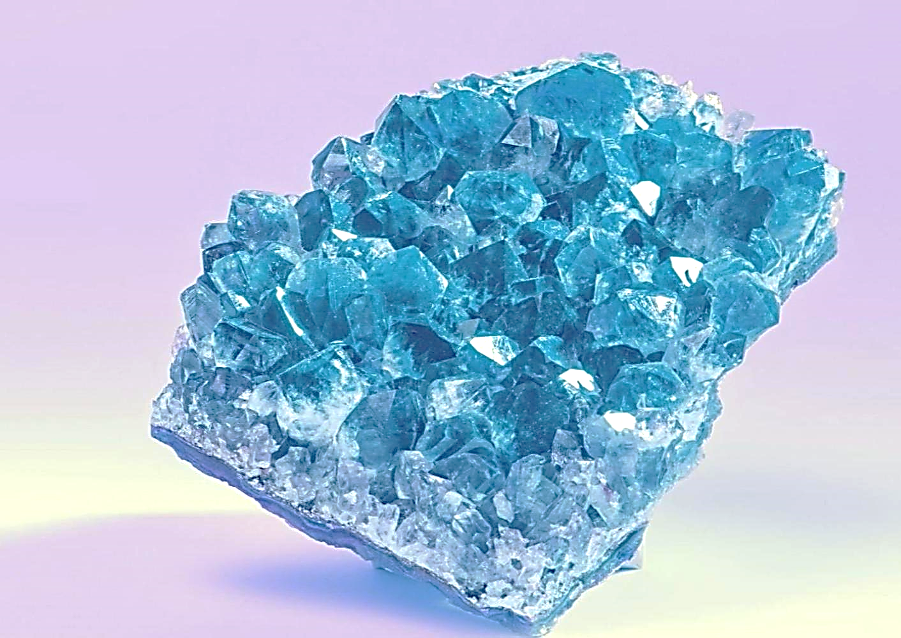
KOBALT & KOLTAN TEKNOLOGY
@1bmlt9
KOKO
@ ³Louanges Tertulle(Tertio) Boukaka Mbombolo
Notes:
KOKO BUTIN {KOBALT+KOLTAN} LUMINGU’3

Slide 2
What is Kobalt?
Kobalt is a chemical element with the symbol CO and atomic number 27. Like nickel, Kobalt is found in the Earth's crust only in chemically combined form, save for small deposits found in alloys of natural meteoric iron. The free element, produced by reductive smelting, is a hard, lustrous, silver-gray metal.
Notes:
KOBALT&KOLTAN =~ YESU {DOUBLE EDGED SWORD} FIRE

Slide 3
Where is KOBALT found?
Notes:
ISAIAH 66 {KOKO} YESU OIL {AM SUN} TECHNOLOGY MAESTRO ETC.

Slide 4
İİ Z 4K 3 📸
@ 2$πL$
@1BMLT9
Notes:
HEAVEN PICTURE OF SHINING K {HTTPS://LUMINGU.NETLIFY.APP/CALLUS}

